Slide 1
Perfect Competition Principles of Microeconomics Boris Nikolaev

Slide 2
Introduction
Firm behavior and efficiency depends on the market structure.
Four market structures:
Perfect Competition
Monopoly
Imperfect (Monopolistic) Competition
Oligopoly

Slide 3
Perfect Competition
Large number of relatively small buyers and sellers. No market power.
Homogeneous products.
Easy entry and exit.
Perfect information of price and availability.
No advertising (or other forms of competition).
Implications:
From 1. and 2. → PC firms are PRICE TAKERS! → P = MR = AR
(i.e. demand is perfectly elastic)
From 3. → Efficiency in the long-run.

Slide 4
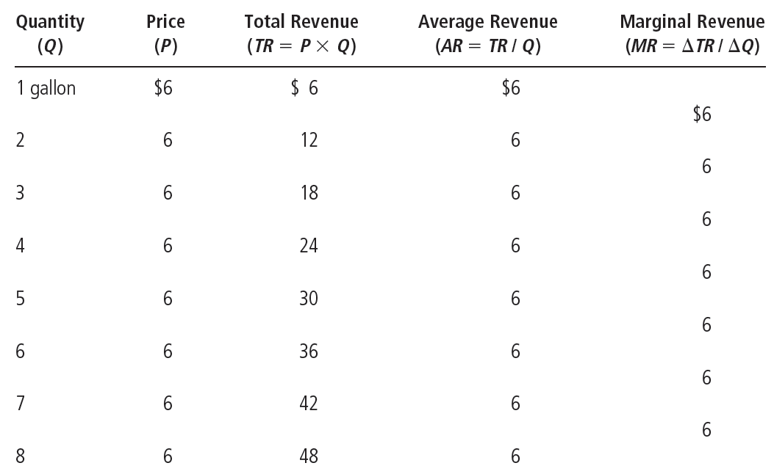
Total, Average, and Marginal Revenue

Slide 5
GOAL: max (profits) = max(TR-TC)
This will happen at the point where MR= MC. Why?

Slide 6
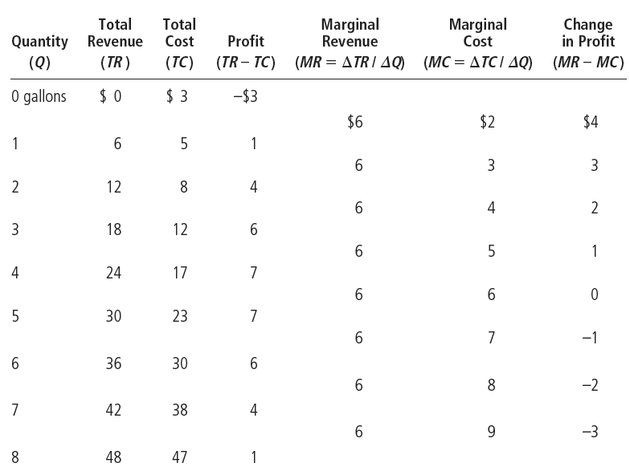
Profit Maximization (MR=MC)

Slide 7
Profit Maximization
The marginal-cost curve and the firm’s supply decision
MC curve – upward sloping
ATC curve – U-shaped
MC curve crosses the ATC curve at the minimum of ATC curve
P = AR = MR

Slide 8
Rules for Profit Maximization
Rules for profit maximization:
If MR > MC – firm should increase output
If MC > MR – firm should decrease output
If MR = MC – profit-maximizing level of output
Marginal-cost curve
Determines the quantity of the good the firm is willing to supply at any price
Is the supply curve

Slide 9
Short-Run (SR) Equilibrium
Costs
and
Revenue
The firm maximizes profit by producing the quantity at which marginal cost equals marginal revenue.
MC
MC₂
ATC
P=MR₁=MR₂
P=AR=MR
AVC
MC₁
0
Q₁
Q_{MAX}
Q₂
Quantity

Slide 10
MC and the Firm’s Supply Curve
Price
MC
P₂
ATC
P₁
AVC
0
Q₁
Q₂
Quantity
An increase in the price from P₁ to P₂ leads to an increase in the firm’s profit-maximizing quantity from Q₁ to Q₂. Because the marginal-cost curve shows the quantity supplied by the firm at any given price, it is the firm’s supply curve.

Slide 11
Shutdown Decision (SR)
The firm’s short-run decision to shut down
TR = total revenue
VC = variable costs
Firm’s decision:
Shut down if TR<VC (P<AVC)
Competitive firm’s short-run supply curve
The portion of its marginal-cost curve
That lies above average variable cost

Slide 12
Shutdown Decision (SR)
Costs
1. In the short run, the firm produces on the MC curve if P>AVC,...
MC
ATC
AVC
2. ...but
shuts down
if P<AVC.
0
Quantity
In the short run, the competitive firm’s supply curve is its marginal-cost curve (MC) above average variable cost (AVC). If the price falls below average variable cost, the firm is better off shutting down.

Slide 13
Short-Run Supply Curve

Slide 14
Long Run
Firm’s long-run decision
Exit the market if
Total revenue < total costs; TR < TC
Same as: P < ATC
Enter the market if
Total revenue > total costs; TR > TC
Same as: P > ATC
Competitive firm’s long-run supply curve
The portion of its marginal-cost curve that lies above average total cost

Slide 15
Long-Run Equilibrium
Costs
1. In the long run, the firm produces on the MC curve if P>ATC,...
MC
ATC
2. ...but exits if P<ATC
0
Quantity
In the long run, the competitive firm’s supply curve is its marginal-cost
curve (MC) above average total cost (ATC). If the price falls below average total cost, the firm is better off exiting the market.

Slide 16
Measuring Profit
Measuring profit
If P > ATC
Profit = TR – TC = (P – ATC) ˣ Q
If P < ATC
Loss = TC - TR = (ATC – P) ˣ Q
= Negative profit

Slide 17
Profit
(a) A firm with profits
(b) A firm with losses
Price
Price
MC
MC
Profit
ATC
Loss
ATC
P
ATC
P=AR=MR
ATC
P
P=AR=MR
0
Q
(profit-maximizing quantity)
0
Quantity
Q
(loss-minimizing quantity)
Quantity
The area of the shaded box between price and average total cost represents the firm’s profit. The height of this box is price minus average total cost (P – ATC), and the width of the box is the quantity of output (Q). In panel (a), price is above average total cost, so the firm has positive profit. In panel (b), price is less than average total cost, so the firm has losses.

Slide 18
Long Run Supply Curve
Why do competitive firms stay in business if they make zero profit?
Profit = total revenue – total cost
Total cost – includes all opportunity costs
Zero-profit equilibrium
Economic profit is zero
Accounting profit is positive

Slide 19
LR Profit
Market – in long run equilibrium
P = minimum ATC
Zero economic profit
Increase in demand
Demand curve – shifts outward
Short run
Higher quantity
Higher price: P > ATC – positive economic profit

Slide 20
Initial Condition
Market
Firm
Price
Price
1. A market begins in
long-run equilibrium…
2. …with the firm
earning zero profit.
Short-run supply, S₁
MC
ATC
A
Long-run
supply
P₁
P₁
Demand, D₁
0
Q₁
Quantity
(market)
0
Quantity
(firm)
The market starts in a long-run equilibrium, shown as point A in panel (a). In this equilibrium, each firm makes zero profit, and the price equals the minimum average total cost.

Slide 21
Increase in Demand
Market
Firm
Price
3. But then an increase in demand raises the price…
Price
4. …leading to
short-run profits.
S₁
MC
ATC
B
P₂
A
P₂
Long-run
supply
P₁
P₁
D₂
D₁
0
Q₁
Q₂
Quantity
(market)
0
Quantity
(firm)
Panel (b) shows what happens in the short run when demand rises from D₁ to D₂. The equilibrium goes from point A to point B, price rises from P₁ to P₂, and the quantity sold in the market rises from Q₁ to Q₂. Because price now exceeds average total cost, firms make profits, which over time encourage new firms to enter the market.

Slide 22
Long Run Response
Market
Firm
Price
Price
6. …restoring long-run equilibrium.
5. When profits induce entry, supply increases and the price falls,…
S₁
MC
S₂
ATC
B
P₂
A
C
Long-run
supply
P₁
P₁
D₂
D₁
0
Q₁
Q₂
Q₃
Quantity
(market)
0
Quantity
(firm)
This entry shifts the short-run supply curve to the right from S₁ to S₂, as shown in panel (c). In the new long-run equilibrium, point C, price has returned to P₁ but the quantity sold has increased to Q₃. Profits are again zero, price is back to the minimum of average total cost, but the market has more firms to satisfy the greater demand.

Slide 23
Efficiency
Allocative
Productive

