Slide 1
Economic Efficiency Principles of Microeconomics 2023 Boris Nikolaev

Slide 2
The Water-Diamond Paradox

Slide 4
Another look at the demand curve…
We can think of the demand curve as
The marginal (additional) benefit from
consuming one more unit of good.
P
D = MB
Q

Slide 5
Consumer Surplus
Difference between what consumers
are willing to pay and what they
actually pay.
P
D = MB
Q

Slide 6
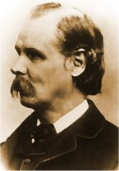
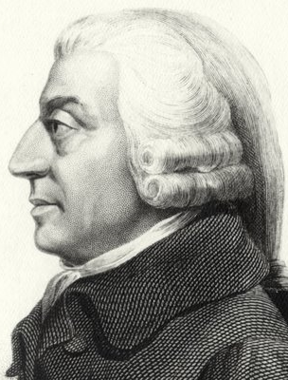
"The price which a person pays for a thing can never exceed, and seldom comes up to that which he would be willing to pay rather than go without it: so that the satisfaction which he gets from its purchase generally exceeds that which he gives up in paying away its price; and he thus derives from the purchase a surplus of satisfaction. The excess of price which he would be willing to pay rather than go without the thing, over that which he actually does pay, is the economic measure of this surplus satisfaction. It may be called consumer’s surplus.“
A. Marshall

Slide 7
Producers Surplus
S=MC
P
Difference between what producers
are willing to sell their product at and
what they actually receive for it.
Q

Slide 8
Efficiency gains from trade
In Just Go With It [watch here]

Slide 9
Efficiency (in a free market)
S
P*
D
Q*

Slide 10
Welfare (deadweight) loss (underproduction)
S=MC
P*
D=MB
Q*

Slide 11
Welfare (deadweight) loss (overproduction)
S
P*
D
Q*

Slide 12
Government Price-Fixing
Price floors (e.g. the minimum wage law)
Price ceilings (e.g. rent control, price gauging)
Price support (e.g., dairy subsidies)

Slide 13
Price Floor (e.g. minimum wage)
S labor
P
P*
min. wage
D labor
Q*

Slide 14
Price Floor (e.g. minimum wage)
S labor
P
min. wage
P*
D labor
Q*

Slide 15
Economic Effects of the Min. Wage Law

Slide 16
Practice Question
When a binding price floor is imposed on a market to benefit sellers,
no sellers actually benefit.
some sellers benefit, but no sellers are harmed.
some sellers benefit, and some sellers are harmed.
all sellers benefit.

Slide 17
Price Ceiling (e.g. rent control)
S
P
rent ceiling
P*
D
Q*

Slide 18
Price Ceiling (e.g. rent control)
S
P
P*
rent ceiling
D
Q*

Slide 19
Economic Effects of Price Ceiling

Slide 20
Work in Pairs
A. Using the graph shown, analyze the effect a $300 price ceiling would have on the market for ten-speed bicycles. Would this be a binding price ceiling?
B. Using the graph shown, analyze the effect a $700 price floor would have on this market for ten-speed bicycles. Would this be a binding price floor?
C. What would be the deadweight loss if there is a $300 price ceiling?

Slide 21
Price Support (dairy price support)
S
P*
P
support
price
D
Q*

Slide 22
Price Support (dairy price support)
S
support
price
P*
P
D
Q*

Slide 23
Economic Effects of Price Support

Slide 24
Work in Pairs
A. Using the graph shown, analyze the effect a $600 price support.
B. What would be the cost of this program to the government (or the US taxpayer?)
C. What would be the deadweight loss if there is a $300 price ceiling?

Slide 25
Should we legalize the market …
… for human organs? [See here]
TRIVIA
Which is the only country in the world with a free market for organs?
India
Switzerland
Iran
Bulgaria
Iraq

Slide 26
Currently…
S
Notice that the supply curve
is vertical. We will call such
curve perfectly inelastic.
P*
P
D
0
Qs*
<
Qd
cost is $0 (donations)
shortage of organs
(89K waiting list + 400 die every year)

Slide 27
What if we had a free market?
S
P*
D
Q*

Slide 28
What about prostitution?

Slide 29
The American Class System
“Who controls the past, controls the future. And those who control the present control the past.”
George Orwell

