Slide 1
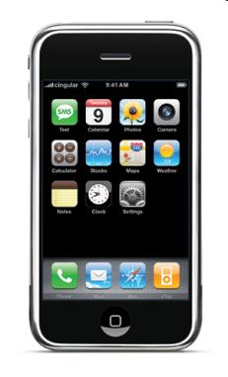
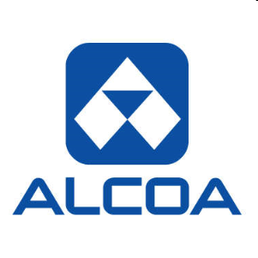
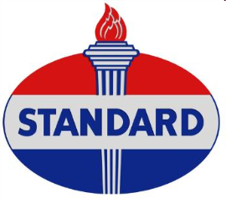
Monopoly
What does monopoly mean?
“monos” = one “polein” = seller
Not a new phenomenon → Thales, Aristotle

Slide 2
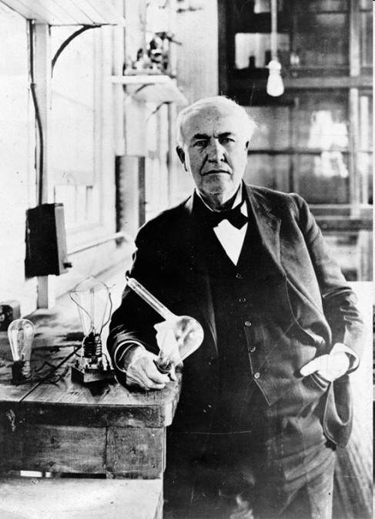
Necessary conditions
Single seller
Examples: most public utility companies and patented drugs.
No close substitutes
Market power
The firm can increase price and not lose all of its customers or demand (D)
is downward sloping. The monopolist is a price maker.
Note: Since we have only one firm market demand = firm demand
Barriers to entry
Patents, licenses, regulation, economies of scale, etc…
Non-price competition
Advertisement, promotions, brand management, etc…

Slide 3
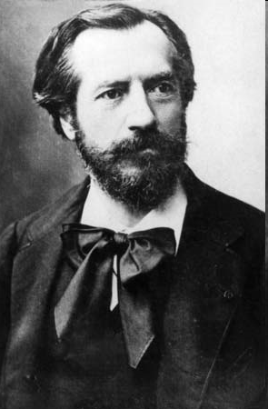
The Statue of Liberty

Slide 4
What creates monopolies?
Legal restrictions (e.g. patents)
Economies of scale
Control of essential resources
Technical superiority
Deliberately created barriers

Slide 5
Legal Restrictions
Patents – awards the inventor the exclusive right to decide who produces the good for 20 years.
Michael Jackson’s patent [watch here]
Benefits / Costs
Trademarks
Patent Trolls
20% of our genes are now patented [read here]
(ACLU sues over patents on breast cancer genes)

Slide 6
Licensing

Slide 7
Economies of Scale
Cost per unit
Long-run
average cost
Quantity per period

Slide 8
Control of Essential Resources
China is a monopoly supplier of Pandas to the world’s zoos. [panda cam]
Alcoa was the sole U.S. maker of aluminum for a long period of time because it controlled the supply of bauxite.
DeBeers (cartel) controls the supply of diamonds.
http://www.guardian.co.uk/business/2009/jul/24/debeers-results-diamonds-recession-impact (due to financial crisis profits decreased 99% for 2010!)
Geographical control (restaurants, zoos, movie theaters, grocery stores, etc…) e.g. Busch Gardens

Slide 9
Technical Superiority
Intel controls 80% of the market for microchips. [Intel ad][2]
Google controls 76% of the search market [read here]

Slide 10
Deliberately created barriers
Predatory pricing
- keep prices low to drive competition out (e.g. Walmart).
http://blog.mises.org/archives/005255.asp (Microsoft accused of predatory pricing).
Excess capacity
- flood the market with product, which has the effect of driving prices down, and eliminating competition.
Limit pricing
- price below cost to prevent new entry (e.g. Alcoa)

Slide 11
Price and MR
Note that P ≠ MR (true for all firms with market power)
Why? To sell more the monopolist has to lower prices. However, this new lower price is for all quantity that is sold.
Example:

Slide 12
Profit Maximization (M)

Slide 13
Efficiency (M)

Slide 14
Drawbacks from Monopoly
Restricted output
Higher prices
Welfare loss to society (DWL)
Equity cost

Slide 15
Why the DWL may be smaller?
Economies of scale.
Public scrutiny.
Predatory pricing to discourage new entry.
Harberger’s study

Slide 16
Why DWL may be higher?
Gordon Tullock’s answer:
THE WELFARE COSTS OF TARIFFS, MONOPOLIES, AND THEFT (1967)
Every time the government restricts output → welfare loss
Monopolies devote resources to preserve their power (lobbying, campaign contributions, etc.)
DUP – Directly Unproductive Activity
Rent-Seeking: companies try to influence public policy that will benefit them at the expense of the taxpayer.
At the end of the day, the loss to society is much higher.

Slide 17
Why DWL may be higher?
Monopolies are regulated by the Government ( as soon as natural monopoly is formed, the next thing that is created is a public utility commission that regulates it). So MC goes up.
Stigler tracked the careers of public commissioners and discovered that 80% of public commissioners after 4 year contract go to work for the industry they regulated.
Stigler’s Capture Theory.
Advertisement – multi-billion dollar campaigns for trivial differentiation → higher prices → restricts output.

Slide 18
Price Discrimination

