Slide 1
Consumer Choice Theory Revisited Principles of Microeconomics Boris Nikolaev

Slide 2
Economic Theory
Consumers have perfect information
Consumers are rational and self-interested agents that maximize their utility
More is better (as you move to a higher indifference curve utility goes up)
Preferences are stable

Slide 3
Welfare /moral implications
Markets are efficient.
Consumers are always making the right choices so they should be free to consume whatever they want.
Economic growth is desirable (more is better). Consumerism.
All goods are equally meritorious. Meritocracy.
Anthropocentrism.
Humans should be separate and self-serving entities.
Robert Frank’s study.

Slide 4
Some questions …
Where do preferences come from? Are all preferences equal?
Should perfect information be the default assumption for our analysis?
Are consumers really rational? Self-interested? Do they maximize utility?
Is more necessarily better? Is economic growth the unequivocal good to pursue?
Are consumers separate and self-serving entities? Should we account for social context?

Slide 5
THE BET
Which gamble would you choose?
If I win, you lose 10 points.
If I lose, you gain 14 points.
B. If I win, you lose 0 points.
If I lose, you gain 2 points.

Slide 6
Expected value vs expected utility
You win $1000 with probability 1/8.
You win $100 for sure.

Slide 7
The St. Petersburg Paradox
Nicolas Bernoulli (1713)
Toss a coin repeatedly until tails appear.
The pot starts at $1, and is doubled every time head shows up (e.g. you win $2 if heads appear on the first toss and tail on the second, $4 if head appears on the second toss, and tail on third, $8, $16 , etc…)
What is the expected value from this game? (assume probability head/tail = ½).
How much would you pay to play this game?

Slide 8
The Expected Utility Hypothesis
Von Neumann-Morgenstern’s axioms
1. Completeness A>B, or A<B, or A=B
2. Transitivity A>B, and B >C, then A>C
3. Independence
A>B, then tA + (1-t)C > tB + (1-t)C
4. Continuity
A>B>C then there exists p s.t. pA+(1-p)C=B
Rational people follow these rules when they make choices.

Slide 9
EUH can explain risk aversion
Decision makers maximize expected utility, not expected value.
max E(U(V)), not U(E(V))

Slide 10
But it cannot explain other behaviors

Slide 11
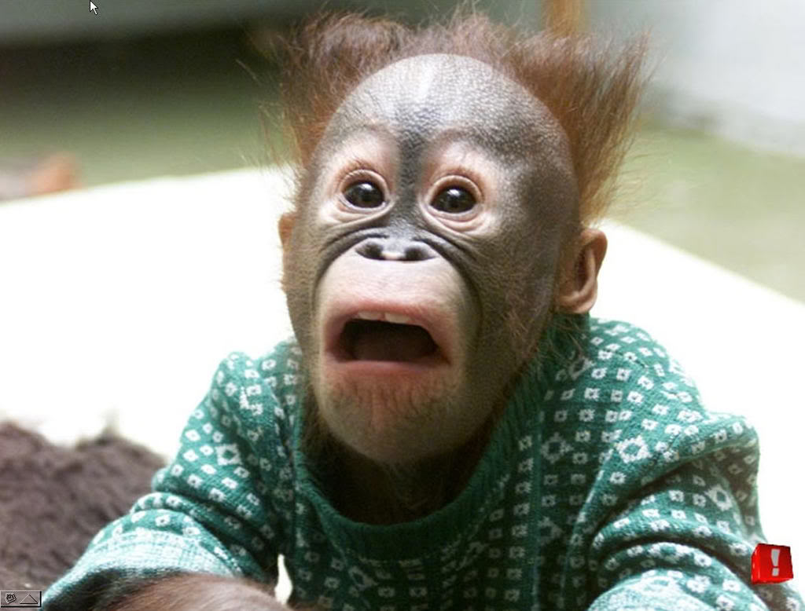
Are people perfectly rational?

Slide 12
How much does the ball cost?
You have a bat and a ball. The total cost is one dollar and ten cents. The bat costs one dollar more than the ball.

Slide 13
The Allais Paradox
Choose between gambles A and B.
Gamble A: .11*$1million + .89*$0
Gamble B: .01*5million + .90*$0
Now, choose between C and D.
Gamble A: 1*$1million
Gamble B: .10*5million + .89*$1million +.01*$0

Slide 14
The Ellsberg Paradox
Suppose you have an urn containing 30 red balls and 60 blue and yellow balls. You don’t know how many blue or yellow balls there are (only that the sum of blue and yellow balls is 60). The balls are well mixed so that each individual ball is as likely to be drawn as any other. You are given a choice between two gambles:
Gamble I:
A: Win $1000 if red.
B: Win $1000 if blue
Gamble B:
C: Win $1000 if not red.
D: Win $1000 if not blue

Slide 15
Framing effects
Kahneman and Tversky [Nobel lecture, 2002]
Problem 1: A rare disease is contracted by 600 people. You can make one of two choices:
A: 200 are saved
B: 1/3 chance that all will be saved, 2/3 chance all will die.

Slide 16
How about now?
Problem 2: A rare disease is contracted by 600 people. You can make one of two choices:
C: 400 die.
D: 1/3 chance that no one dies; 2/3 chance that all die.

Slide 17
Problem 2
Choose between gamble A and B or between C and D.
A: $240 w/ certainty
B: 25% $1000 and 75% $0
C: sure loss of $750
D: 75% of losing $1000 and 25% chance of losing nothing

Slide 18
Prospect Theory
People are risk-averse when facing gains.
& risk-loving when facing a loss.
Framing effects – thinking in relative terms; not absolute ones.
Certainty effect.

Slide 19
Prospect Theory

Slide 20
Do people maximize?
Herbert Simon [Nobel lecture, 1978]
Bounded rationality
Satisficing

Slide 21
The curse of dimensionality
8 products with 8 different attributes. 16.7 million different combinations of these goods.

Slide 22
Thinking Traps
Imagine there is a terrible disease reported, and although it affects only one in ten thousand people, it is absolutely lethal. You are worried about it, so you decide to undergo a medical test to see if you have the disease. No medical test is 100 percent accurate, but your doctor explains that this one is 99% accurate, regardless of whether or not you have the disease (in other words, it will deliver a correct positive or negative 99% of the time). You decide to take the test. You are a little nervous, but you think it’s a sensible thing to do. A blood sample is taken, and you are told the results will be send to you in a week.
A week later the envelop arrives from the testing center. You open it up and read the contents. Staring you in the face is the answer that you dreaded: the results are positive. The results have indicated that you have the lethal disease. And you are right to be, aren’t you?
How likely you are to have the disease?

Slide 23
The Gambler’s Fallacy
I toss a coin several times, and record if it lands heads (H) or tails (T).
1. HHHHHHH
2. TTTTTTH
3. HTTHTH
Which is most likely to be the real outcome?

Slide 24
The Monty Hall problem
[watch here] and [play here]

Slide 25
Superstitious Thinking
Skinner’s experiments [watch here]
Why people believe weird things [watch here]

Slide 26
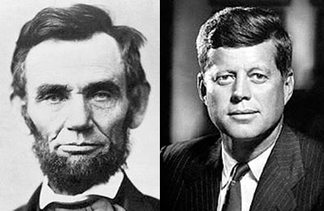
Abraham Lincoln was elected to Congress in 1846, and President in 1860. John F. Kennedy was elected to Congress in 1946, and President in 1960.
Both Presidents were shot on a Friday. Both Presidents were shot in the head Lincoln 's secretary was named Kennedy. Kennedy's Secretary was named Lincoln . Both were assassinated by Southerners. Both were succeeded by Southerners named Johnson. Andrew Johnson, who succeeded Lincoln , was born in 1808. Lyndon Johnson, who succeeded Kennedy, was born in 1908.
John Wilkes Booth, who assassinated Lincoln , was born in 1839. Lee Harvey Oswald, who assassinated Kennedy, was born in 1939.
Lincoln was shot at the theater named 'Ford.' Kennedy was shot in a car called ' Lincoln ' made by 'Ford.' Lincoln was shot in a theater and his assassin ran and hid in a warehouse. Kennedy was shot from a warehouse and his assassin ran and hid in a theater. Booth and Oswald were assassinated before their trials.
A week before Lincoln was shot, he was in Monroe , Maryland A week before Kennedy was shot, he was in Marilyn Monroe.

Slide 27
Intuition vs Reason

Slide 28
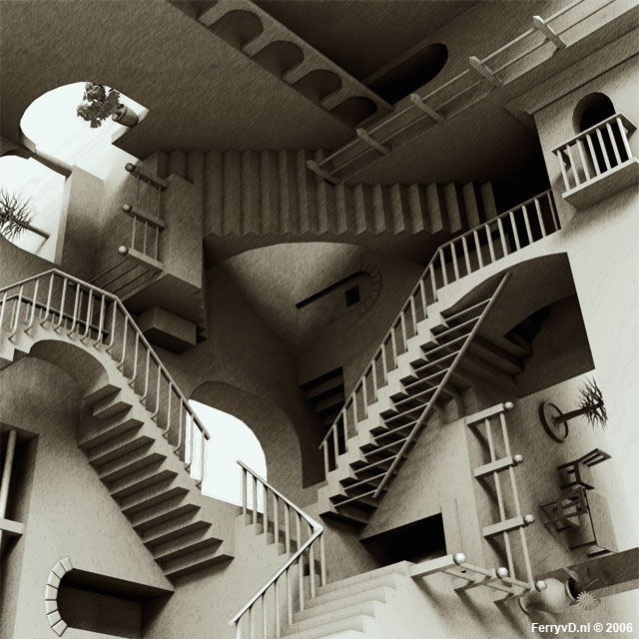
Perception is reference dependent
http://web.mit.edu/persci/gaz/gaz-teaching/flash/koffka-movie.swf (Kofka ring)
http://www.youtube.com/watch?v=l-_NneB5fmY (circle illusion)

Slide 29
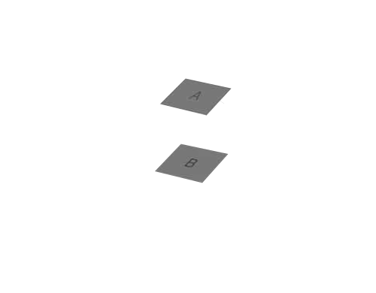
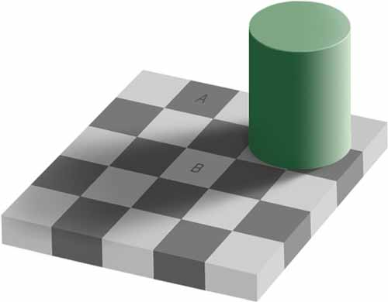
Which is lighter? A or B?

Slide 30
The Human Brain
Brain size has almost tripled over the last 2 million years.
Homo erectus
Homo sapiens

Slide 31
Much of the growth in brain size is associated with the development of the frontal lobe and pre-frontal cortex (where simulation takes place).
Frontal lobe
Pre-frontal
cortex

Slide 32
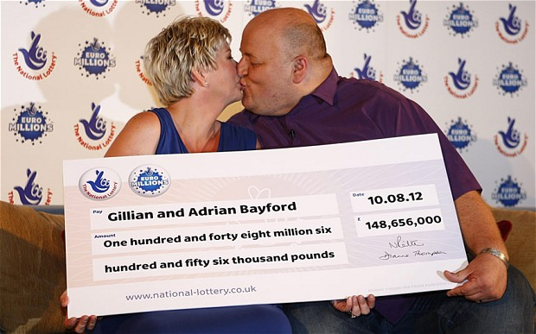
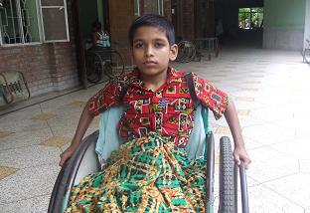
Quiz
How smart is your pre-frontal cortex?

Slide 33
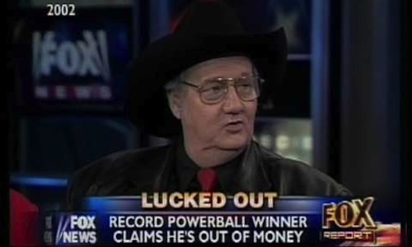
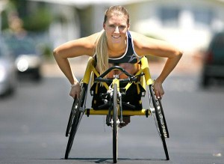
A year later…
Both lottery winners and paraplegics report levels of happiness similar to their happiness prior to the major life event.

Slide 34
Impact Bias
We often fail to estimate how much utility (happiness) our choices will bring us.
Romantic partner
Passing a college exam
Medical tests
Injuries
Sporting events
Weight loss

Slide 35
Expected vs Experienced Utility
Neoclassical Economics: Utility cannot be measured, but revealed through choices.
Behavioral Economics: We can measure utility (at least to some extent)

Slide 36
Experienced Utility
One way to measure experienced utility is simply to ask people how happy they are.
This is a convenient shortcut.
“Taken all together, how would you say things are these days - would you say that you are very happy, pretty happy, or not too happy?”
– General Social Survey

Slide 37
Are we in control of our decisions?
TED Videos: Predictably irrational (series of 11 talks) [watch here]

Slide 38
Optimism Bias
Optimism bias [watch here]

Slide 39
Projection Bias
The hungry shopper
Membership in gyms

Slide 40
Context Choice

Slide 41
Learning from the Past

Slide 42
Libertarian Paternalism

Slide 43
Preferences
What if preferences are NOT “given.”
Where do our wants come from?
Evolution, culture, past consumption, influence of firms.
The effect of advertising on our choices.
2.1% of GDP ~ $1000 per capita (too big to ignore).
J K Galbraith, The Affluent Society (1958)
Juliet Schor, Born to Buy (2004)
Children as evolving consumers
Chomsky, Manufacturing Consent (2002)
Implication for economic (welfare) analysis?

Slide 44
More is better!
“The ultimate purpose is … to consume more consumer goods”
President Eisenhower

Slide 45
The paradox of our time in history is that we have taller buildings, but shorter tempers; wider freeways, but narrower viewpoints; we spend more, but have less; we buy more, but enjoy it less. We have bigger houses and smaller families; more conveniences, but less time; we have more degrees, but less sense; more knowledge, but less judgment; more experts, but more problems; more medicine, but less wellness. We drink too much, smoke too much, spend too recklessly, laugh too little, drive too fast, get angry too quickly, stay up too late, get up too tired, read too seldom, watch TV too much, and pray too seldom. We have multiplied our possessions, but reduced our values. We talk too much, love too seldom, and hate too often. We've learned how to make a living, but not a life; we've added years to life, not life to years. We've been all the way to the moon and back, but have trouble crossing the street to meet the new neighbor. We've conquered outer space, but not inner space; we've done larger things, but not better things. We've cleaned up the air, but polluted the soul; we've split the atom, but not our prejudice. We write more, but learn less; we plan more, but accomplish less. We've learned to rush, but not to wait; we have higher incomes, but lower morals; we have more food, but less appeasement; we build more computers to hold more information to produce more copies than ever, but have less communication; we've become long on quantity, but short on quality. These are the times of fast foods and slow digestion; tall men, and short character; steep profits, and shallow relationships. These are the times of world peace, but domestic warfare; more leisure, but less fun; more kinds of food, but less nutrition. These are days of two incomes, but more divorce; of fancier houses, but broken homes. These are days of quick trips, disposable diapers, throw away morality, one-night stands, overweight bodies, and pills that do everything from cheer to quiet to kill.

Slide 46
The cost of consumerism
Environmental problems (global warming, pollution) [UN report]
Credit card debt (personal freedom) [fred][debt clock]
More stress (depression, anxiety)
Less leisure, more work
Social relationships (divorce, time with family & friends)
Moral
Happiness (doubtful)

Slide 47
Anti-consumerism

Slide 48
Anti-consumerism

Slide 49
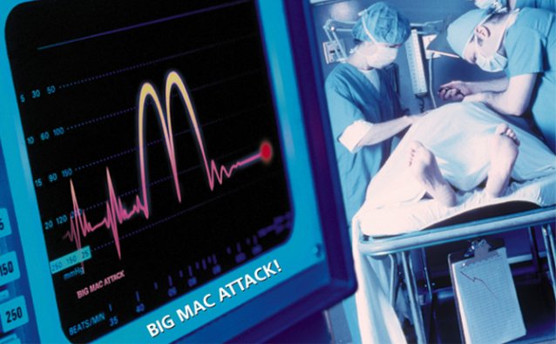
Anti-consumerism

Slide 50
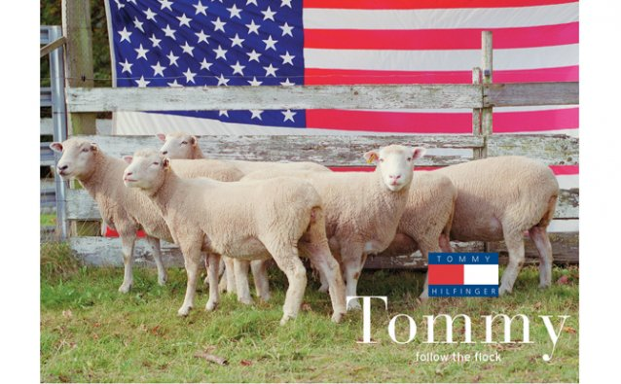
Anti-consumerism

Slide 51
The Paradox of Choice

Slide 52
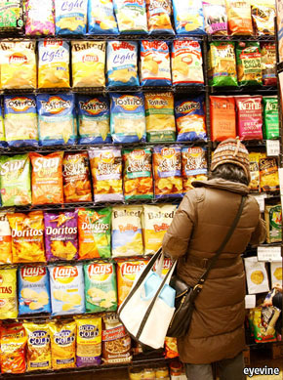

Slide 53
Less stuff, more happiness
Graham Hill [watch here]

Slide 54
Can money buy happiness?

