Slide 1
Elasticity Principles of Microeconomics Boris Nikolaev

Slide 2
$39,500,000,000
The highest profit ever made by a company in a year.
GDP of Bulgaria (7.6 million people)
2x GDP of Cyprus (lose to 1 million)
5 x GDP of Zimbabwe (12.5 million people)

Slide 3
It turns out…
[source]
2008 → $40,610,000,000.
2009 → 45,220,000,000.
What about 98?
1955? (as far as data goes).

Slide 4
Who gets what from a liter of oil in the G7?
[ source ]

Slide 5
$175,189,824
Lobbying in 2009.
Oil companies one of the largest spenders in Washington.
Surprised?
Taxes paid by 5 corporate giants [right here]

Slide 6
What allows …
… oil companies to make such high profits?
… governments to tax so heavily oil (and raise huge revenues)?
…and, why oil?

Slide 7
Elasticity
S
P*
D
Q*

Slide 8
What is elasticity?
Since price and demand are negatively related,
the elasticity of demand will be ____________.

Slide 9
Elasticity of Demand
When Ed > -1 demand is “inelastic”
The relative change in quantity demanded is less than the relative change in price.
When Ed < -1 demand is “elastic”
The relative change in quantity demanded is greater than the relative change in price.
When Ed = -1 demand is “unit elastic”
The relative change in quantity demanded is the same as the relative change in price.

Slide 10
Elastic Demand
Ed < -1
The relative change in quantity demanded is more than the relative change in price.
Demand is very responsive to changes in price

Slide 11
Inelastic Demand
Ed > -1
The relative change in quantity demanded is less than the relative change in price.
Demand is not very responsive to changes in price

Slide 12
Inelastic Demand
P*
D
Q*

Slide 13
Elastic Demand
P*
D
Q*

Slide 14
Perfectly Inelastic Demand
D
Q*

Slide 15
Perfectly Elastic Demand
P*
D

Slide 16
Estimated Price Elasticities of Demand for Various Goods
http://www.mackinac.org/1247

Slide 17
Algebraic Examples
1. You run a 10% off sale. If Ed = -2, how much more do you expect to sell?
2. You have an overstock and need to sell 30% of your inventories. If Ed = -0.6, how much should you lower price?

Slide 18
Elasticity and Total Revenue
When demand is elastic, a decrease in price will increase total revenue.
When demand is inelastic, a decrease in price will decrease total revenue.

Slide 19
Why farmers don’t always like good weather?
S
P*
D
Q*

Slide 20
The market for drugs
P*
D
Q*

Slide 21
Should we legalize drugs?
Milton Friedman on drugs [watch here]
Ron Paul [watch here]

Slide 22
Determinants of Elasticity
Availability of substitutes.
Fraction of income absorbed.
Passage of time.
What kind of a good it is.

Slide 23
Substitutes and Complements

Slide 24
Normal and Inferior Goods

Slide 25
Tax Incidence (e.g per unit tax)

Slide 26
Algebraic example
P = 10+Q P= 100-Q
unit tax = $10

Slide 27
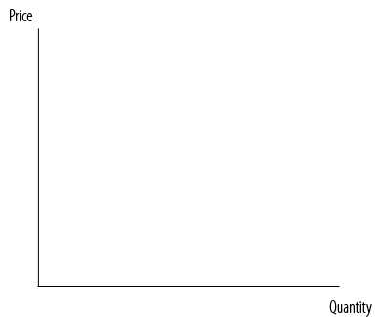
Who pays the tax?
Elastic D, Inelastic S
Inelastic D, Elastic S
Note: The tax moves toward inelasticity

Slide 28
Determinants of welfare loss
Elasticity
2. Taxes

