Slide 1
Supply, Demand & Market Equilibrium Principles of Microeconomics Boris Nikolaev

Slide 2
Why is it that…
… the president of USF earns less than the football coach? [link]
… 30-sec Super Bowl ad costs $3 million in 2011? [ link ] [link]
… oil reached $147/barrel in the summer of 2008, then dropped to $30, and now is on the rise again.
… people are willing to pay $600 for a pound of coffee?
…economists earn more than most other college majors?
most lucrative college majors [ link ]

Slide 3
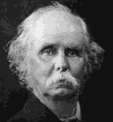
We owe this to…
S
Alfred Marshall
Price (independent variable)
D
Quantity (dependent variable)

Slide 4
How much?
Qd (how much you consume)= f ( … )

Slide 5
The Demand Curve
Price
Quantity

Slide 6
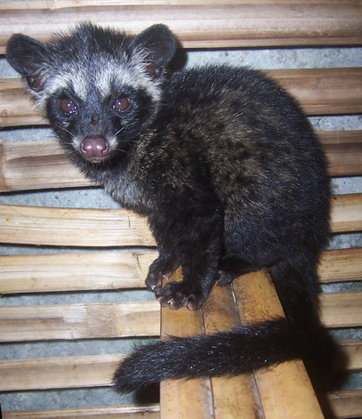
Are you willing to pay $50 for a cup of coffee?
http://www.youtube.com/watch?v=1Q7IYpLYQ7Q (what is it?)
http://en.wikipedia.org/wiki/Kopi_Luwak#Economics (wiki article)
http://www.volcanicacoffee.com/estate-coffee/kopi-luwak-coffee.htm (buy it here)

Slide 7
Demand
Demand (schedule or curve)
Quantity Demanded
The Law of Demand: As price goes up, quantity demanded goes ________.
Individual vs Market Demand

Slide 8
Shifts in D vs Qd
C
A
B

Slide 9
Shifts in Demand

Slide 10
Determinants of Demand (the “other things” we held constant before)
Tastes / Preferences [link] [link]
Number of buyers
Income
Normal Goods
Inferior Goods
Prices of related goods
Substitutes
Complementary
Expectations
Change in availability of credit [link]

Slide 11
What!?
[ click here to find out ]

Slide 12
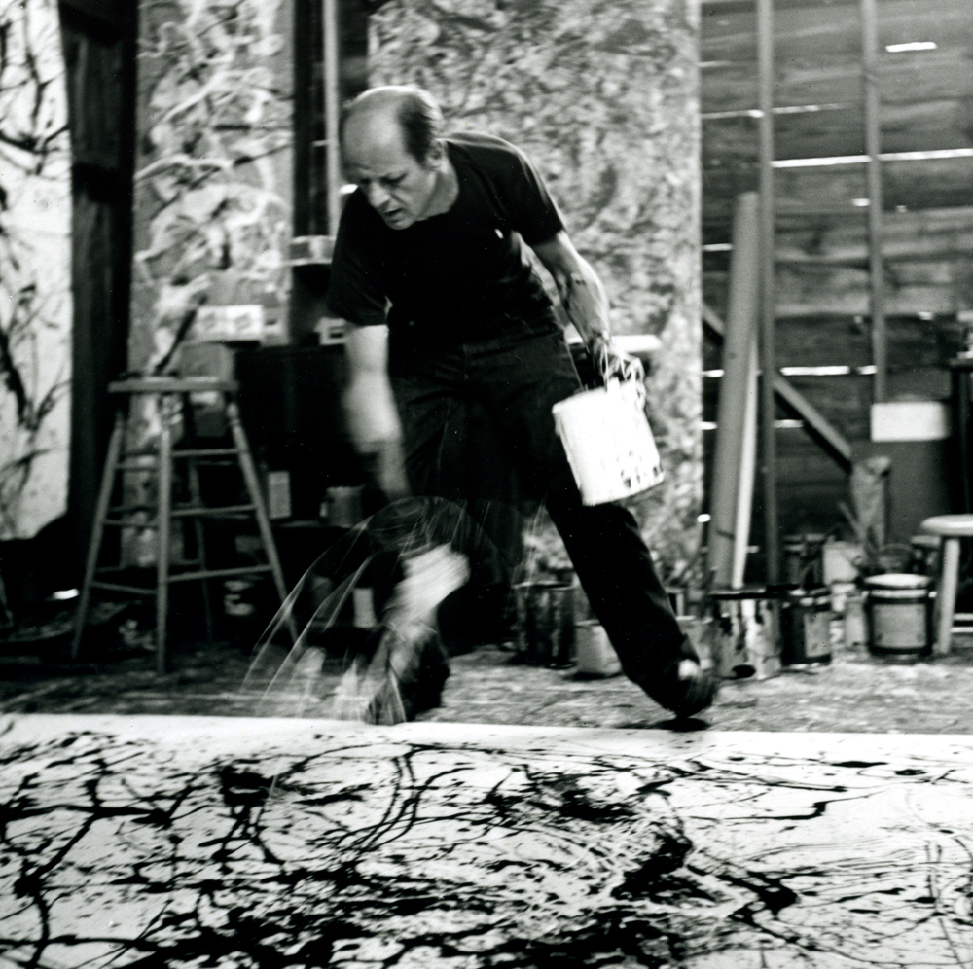

Slide 13
Supply
[link]
Supply (schedule or curve)
Quantity Supply
The Law of Supply: As price goes up, quantity supplied goes ________.
Individual vs Market Supply

Slide 14
Shifts in S vs Qs
A
B
C

Slide 15
Shifts in Supply

Slide 16
Determinants of Supply (the “other things” we held constant before)
Input Prices
Technology
Taxes + Subsidies
Prices of related goods
Expectations
Number of sellers
Available credit
Nature (agriculture)

Slide 17
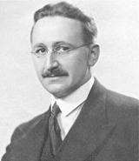
Markets & Prices
The problem of knowledge
dispersed
wrong
tacit
Markets as a solution to the knowledge problem.
What do relative prices represent?
Why are profits important?
F. Hayek

Slide 18
Market Equilibrium
S
Equilibrium
Qs = Qd
P*
D
Q*
The law of supply and demand

Slide 19
P > P*
S
P
P*
D
Q*

Slide 20
P < P*
S
P*
P
D
Q*

Slide 21
Finding Equilibrium P* and Q*
Consider the following supply and demand curves:
P=100-Q P=10+2Q
Which curve represents demand? supply?
What is equilibrium P* and Q*?
What kind of a shift P=200-Q reflects?
What about P=100-2Q?
What would be the effect on P* and Q*?

Slide 22
How did oil prices reach $147/barrel? Then plummeted back to $30…and now are on the rise again.
1973 – Arab Israeli War
OPEC restricts supply

Slide 23
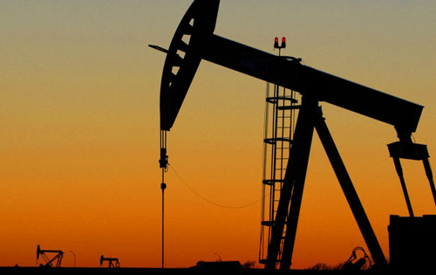
Why is it hard to predict oil prices?
Organization of Petroleum Exporting Countries http://www.opec.org/home/
Speculation
Availability
Extraction
Political unrest
Investment ($)
BBC article on oil prices: http://news.bbc.co.uk/2/hi/business/7425489.stm
George Bush on oil: http://www.thedailyshow.com/watch/thu-march-6-2008/crude-awakening

Slide 24
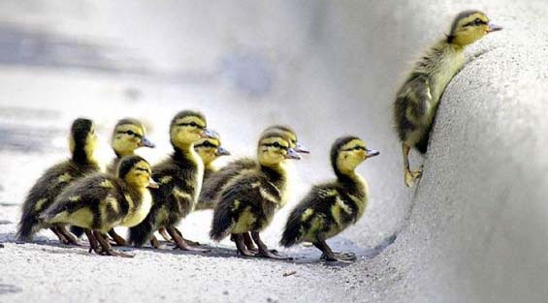
The Fallacy of Supply and Demand
http://www.youtube.com/watch?v=FaO3aGmuNFc (D. Ariely)
Are people like ducklings?
http://www.youtube.com/watch?v=FaO3aGmuNFc (D. Ariely)

